Slide 1
Data Mining for Entity Relationship Associations School of Engineering and Applied Science Department of Computer Science CSCI 6443– Data Mining
Professor: A. Bellaachia
Student: R. Gross (G47667332)

Slide 2
Problem Definition
Many chatbots are a combination of expert systems and machine learning.
A knowledge base is often used as the “brain” of the chatbot due to its ability to perform inference.
Traditionally knowledge bases perform inference based on inference rules, which are brittle and don’t scale well.
Jena
has
Inference!
Child
is a
Parent
IF <subject> has Child
THEN <subject> is a Parent

Slide 3
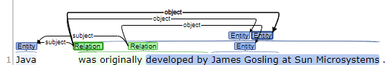
Problem Definition Continued
Unsupervised learning of entity relationships is difficult and supervised learning datasets are costly to create.
Performance is subjective and language dependent.
State-of-the-art NLP algorithms struggle to perform Relationship Extraction (RE) with the precision and recall of a person.
https://corenlp.run/

Slide 4
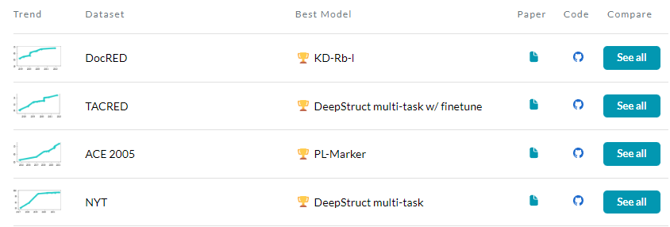
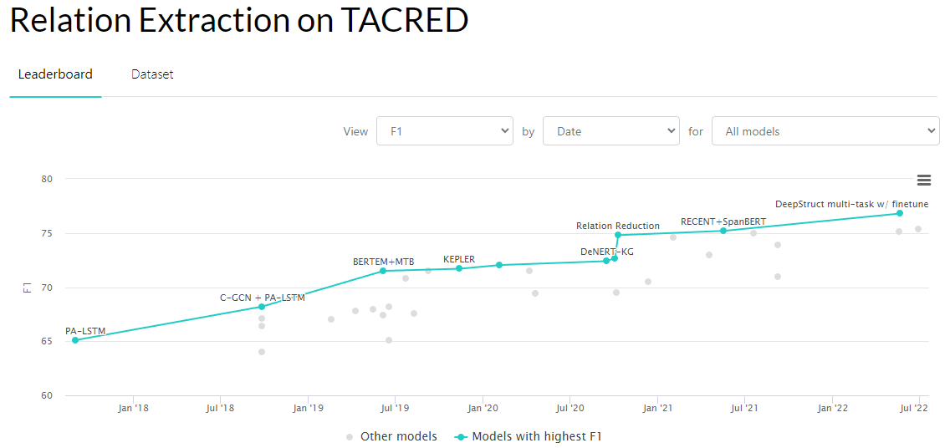
Related Work
Datasets (not all are free):
https://paperswithcode.com/datasets?task=relation-extraction
Papers:
https://paperswithcode.com/task/relation-extraction#papers-list
Notable Algorithms Types:
Open Information Extraction (OpenIE)
Convolutional Neural Network (CNN)
Sequence based networks (RNN, LSTM, GRU, Transformers)
https://paperswithcode.com/task/relation-extraction

Slide 5
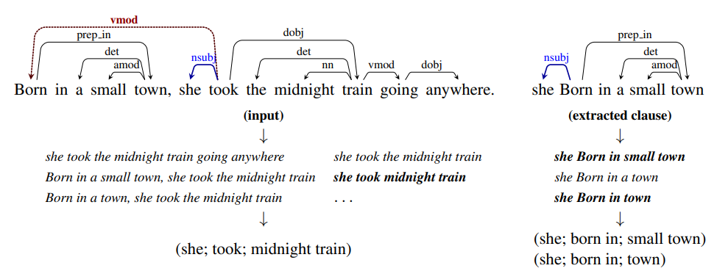
Related Work Continued
Methods of doing RE :
OpenIE
Greedy search on dependency tree
Goal is to reduce sentence to utterance, and keep reducing until triple is all that is remaining
https://nlp.stanford.edu/pubs/2015angeli-openie.pdf

Slide 6
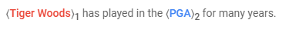
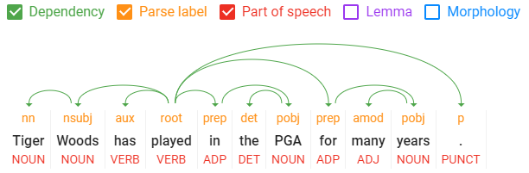
Related Work Continued
Methods of doing RE:
Named Entity Extraction (NER) + Classification of relations between entities using neural networks
Text and/or Part of Speech (POS) tags are input features along with entities
Graph Convolutional Neural Networks (GCN)
Create graph from dependencies
GCN learns features and structures in graph that are associated to training data
NER Example
https://cloud.google.com/natural-language
https://cloud.google.com/natural-language

Slide 7
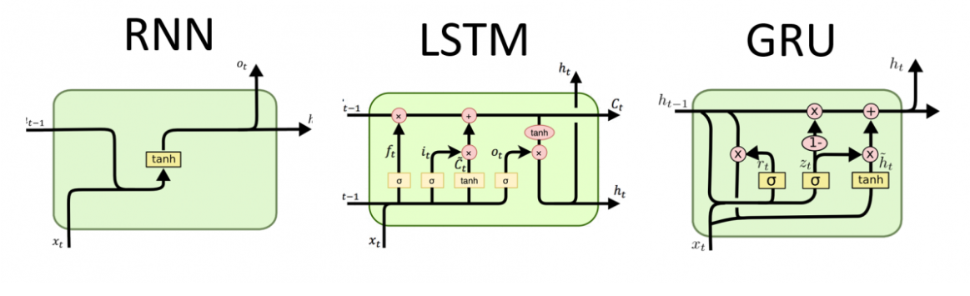
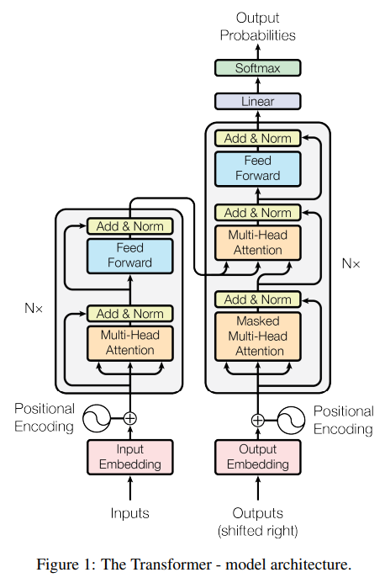
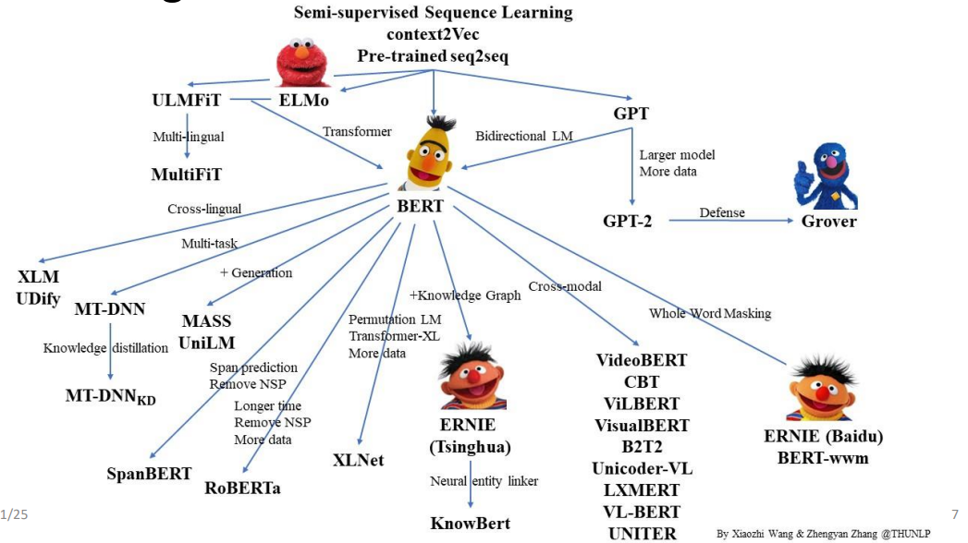
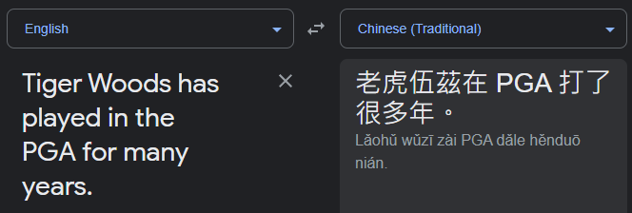
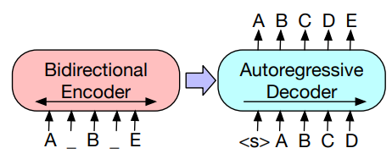
Related Work Continued
http://dprogrammer.org/rnn-lstm-gru
Methods of doing RE :
Applying language generation/translation techniques
RNN, LSTM, GRU, Transformers (Seq2Seq (BERT, ERNIE, GPT, BART))
https://arxiv.org/pdf/1706.03762.pdf
https://www.microsoft.com/en-us/research/uploads/prod/2021/06/Pre-training-Models-Xu-Tan.pdf
https://translate.google.com/
BART
https://arxiv.org/pdf/1906.07510v8.pdf

Slide 8
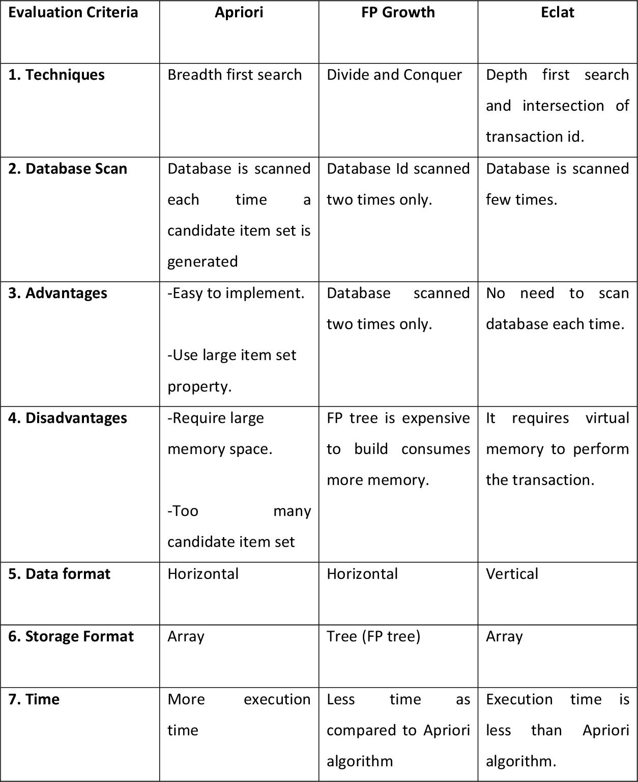
Related Work Continued
After RE, associations between relations occurs.
Leading association algorithms are:
Apriori (Low Mem, Slow Speed)
Eclat (Medium Mem, Medium Speed)
FP Growth (High Mem, Fast Speed)
https://www.semanticscholar.org/paper/Market-basket-analysis-for-improving-the-of-and-FP-Khan-Solaiman/99115afbb9202eba44c7522dccdf71fec8fd6b21

Slide 9





Proposed Approach
Text already mined and transforming to JSON files
Zipped text moved to AWS cloud environment
This allows servers to access as needed with higher download speeds
Download data
Unzip
Split into manageable data message sizes
Publish text to queue
High performance queue
Allows consuming service to be parallel by ensuring only one consumer gets each message
Perform Relation Extraction (RE) to convert unstructured data to structured data
Write to DB
Clean, Transform, and Filter Structured Data
DB Scans and Queries
Apply FP Growth
Text Dataset
Amazon Simple Storage Service (Amazon S3)
Amazon Elastic Compute Cloud (Amazon EC2)
Amazon Simple Queue Service (Amazon SQS)
Amazon Elastic Compute Cloud (Amazon EC2)
Amazon Neptune

Slide 10
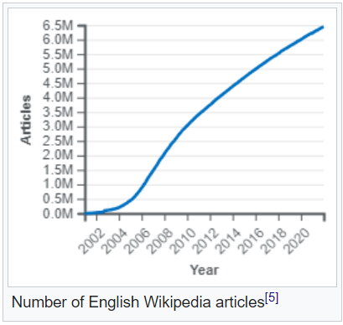
Selected Dataset
Wikipedia
6.5M+ English articles as of 2022
10TB of data as of 2015
https://dumps.wikimedia.org/enwiki/latest/
https://www.kaggle.com/datasets/ltcmdrdata/plain-text-wikipedia-202011
https://github.com/daveshap/PlainTextWikipedia
https://en.wikipedia.org/wiki/Wikipedia:Size_of_Wikipedia

Slide 11
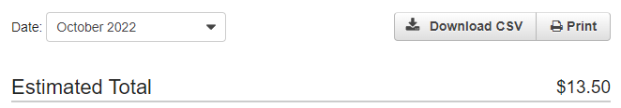
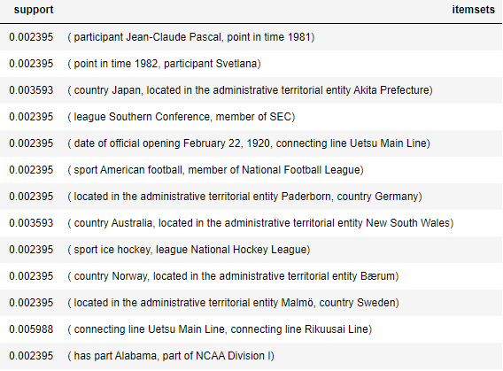
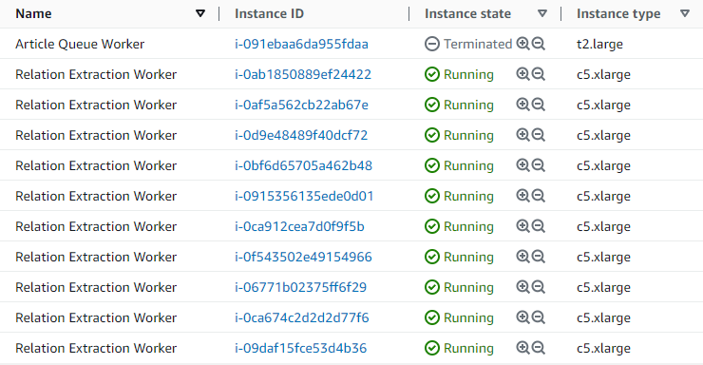
Current Progress
Some early associations
Washington Capitals
sport
Inference!
league
Ice Hockey
National Hockey League

Slide 12
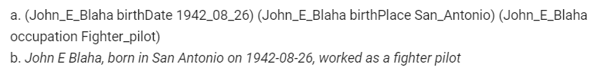
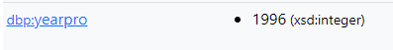
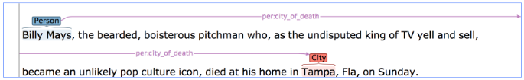
Future Work
https://webnlg-challenge.loria.fr/
Generate a new set of training data
Start with generated triples by determining how often entities and verbs/predicates appear in the same sentence
Use transformer to generate sentences from generated triple
This would give the algorithm a more direct triple to sentence training
https://dbpedia.org/page/Tiger_Woods
https://en.wikipedia.org/wiki/Tiger_Woods
https://nlp.stanford.edu/projects/tacred/

Slide 13

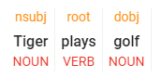
Future Work Continued
0.8
0.8
0.8
…
…
…
…
…
…
0.2
0.2
0.2
Investigate methods of factoring in POS tags and parse labels
Helps to generalize
Due to generalization could reduce training size needed
Tiger
plays
golf
Typical text encoding
0.8
0.8
0.8
…
…
…
…
…
…
0.2
0.2
0.2
Tiger
plays
golf
nsubj
noun
root
verb
root
verb
https://cloud.google.com/natural-language
Can we do this?

